Slide 1
EE227 – Digital Logic Design
Lecture 10

Slide 2
Outline
Prime Implicants and Essentials
Product of Sum Simplification
Don’t Care Conditions

Slide 3
K-Map - Rules of Simplification
Groups may not include any cell containing a zero
Groups may be horizontal or vertical, but not diagonal
Groups must contain 1, 2, 4, 8, or in general 2^{n} cells
Each group should be as large as possible
Each cell containing a one must be in at least one group
Groups may overlap
Groups may wrap around the table
There should be as few groups as possible

Slide 4
Number of Literals and Group Size
For 2 variable k – map
Group of 1 entry → 2 literals
Group of 2 entries → 1 literal
Group of 4 entries → 1
For 3 variable k – map
Group of 1 entry → 3 literals
Group of 2 entries → 2 literal
Group of 4 entries → 1 literal
Group of 8 entries → 1
For 4 variable k – map
Group of 1 entry → 4 literals
Group of 2 entries → 3 literals
Group of 4 entries → 2 literals
Group of 8 entries → 1 literal
Group of 16 entries → 1

Slide 5
Prime Implicants and Essentials (1/3)
In choosing adjacent squares in a map, we must ensure that
All the minterms of the function are covered when we combine the squares
The number of terms in the expression is minimized
There are no redundant terms (i.e., minterms already covered by other terms)
Sometimes there may be two or more expressions that satisfy the simplification criteria
The procedure for combining squares in the map may be made more systematic with the help of these definitions
A prime implicant is a product term obtained by combining the maximum possible number of adjacent squares in the map
If a minterm in a square is covered by only one prime implicant, that prime implicant is said to be essential

Slide 6
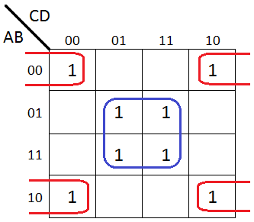
Prime Implicants and Essentials (2/3)
Both Groups are Essential Prime Implicants

Slide 7
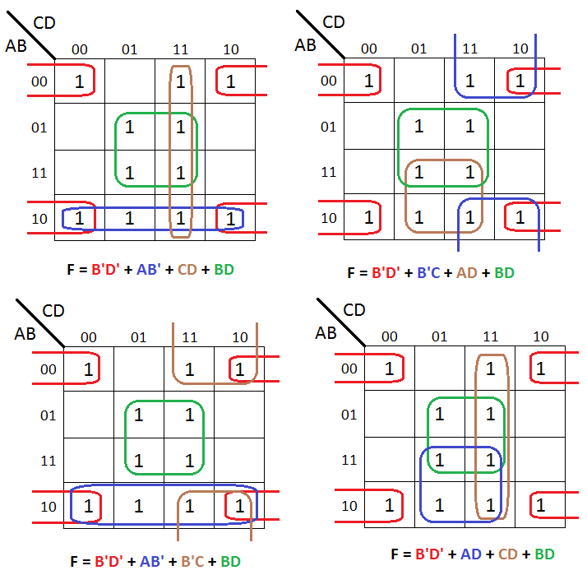
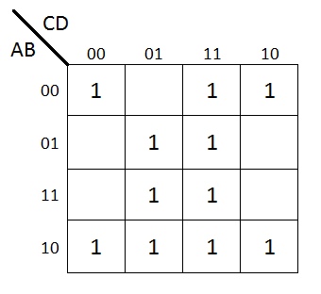
Prime Implicants and Essentials (3/3)
Four Possible Solutions
B’D’ and BD are Essential Prime Implicants; Others are Prime Implicants

Slide 8
Product of Sum Simplification
The 1’s placed in the k-map represent the minterms present in the function
The 0’s represent the minterms not included in the function and hence is the complement of the same function
In order to present the function as product of sum
Combine squares containing 0’s
Then compute the complement of the obtained example
The simplified function in now in product of sum

Slide 9
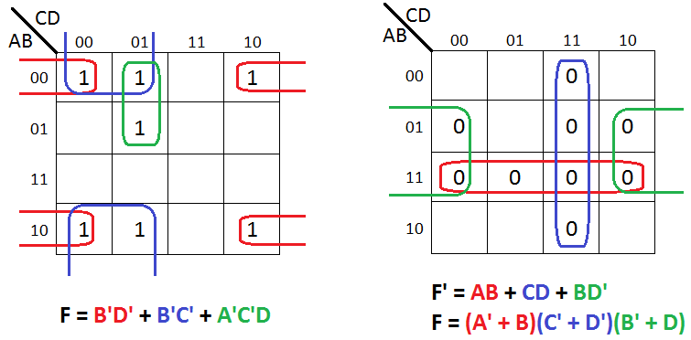
Practice Problem 1
Simplify the following Boolean function into
Sum-of-products form
Product-of-sums form

Slide 10
Don’t Care Conditions
The logical sum of the minterms associated with a Boolean function specifies the conditions under which the function is equal to 1
The function is equal to 0 for the rest of the minterms
Functions that have unspecified outputs for some input combinations are called incompletely specified functions
A don’t-care minterm is a combination of variables whose logical value is not specified
Don’t care conditions are indicated with X in k-map and truth tables and can be taken as 0 or 1

Slide 11
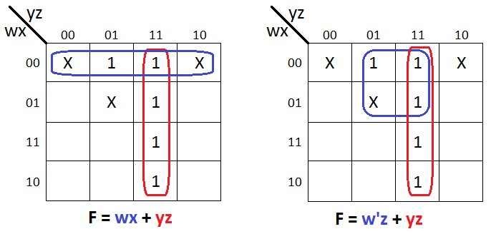
Practice Problem 2
Simplify the Boolean Function
Which has the don’t care conditions
Both Results are Valid

Slide 12
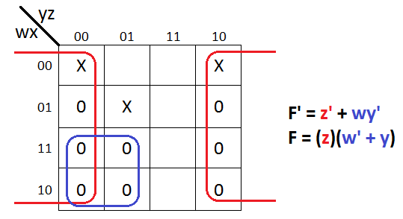
Practice Problem 3
Simplify the Boolean Function in POS form
Which has the don’t care conditions

Slide 13
Practice Problem 4
Find all the prime implicants for the following Boolean functions, and determine which are essential
F(w, x, y, z) = Σ(0, 2, 4, 5, 6, 7, 8, 10, 13, 15)
F(A, B, C, D) = Σ(0, 2, 3, 5, 7, 8, 10, 11, 14, 15)

Slide 14
Practice Problem 5
Simplify the following Boolean functions F, together with the don’t-care conditions d
F(x, y, z) = Σ(0, 1, 4, 5, 6)
d(x, y, z) = Σ(2, 3, 7)
F(A, B, C, D) = Σ(0, 6, 8, 13, 14)
d(A, B, C, D) = Σ(2, 4, 10)
F(A, B, C, D) = Σ(5, 6, 7, 12, 14, 15)
d(A, B, C, D) = Σ(3, 9, 11)

